Slide 1

Surface Hub 2S Teams Guide

Slide 2
Table of contents
Schedule a Teams meeting – Schedule with Teams
Join or Start a Teams meeting – Start from Welcome screen
Teams meeting controls – Video, Microphone, Share, Whiteboard
Teams meeting options – Full screen, change camera
Add someone to the meeting – Invite participants

Slide 3

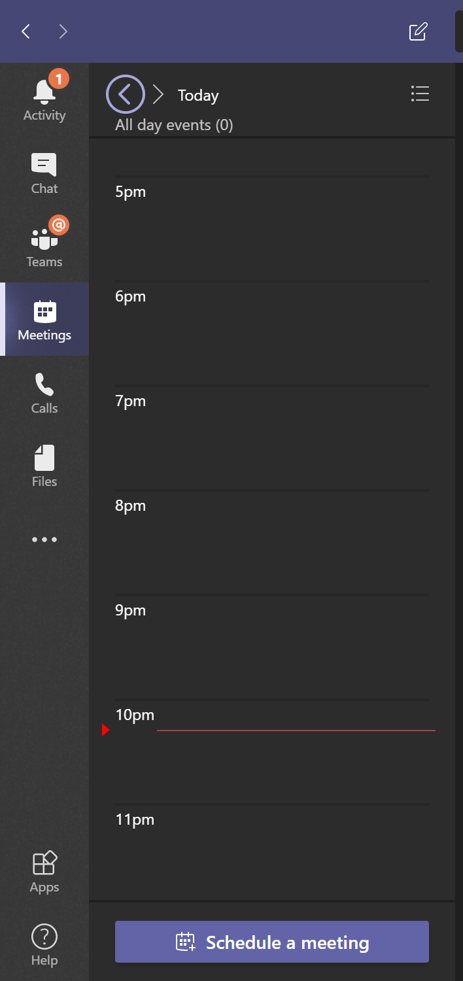
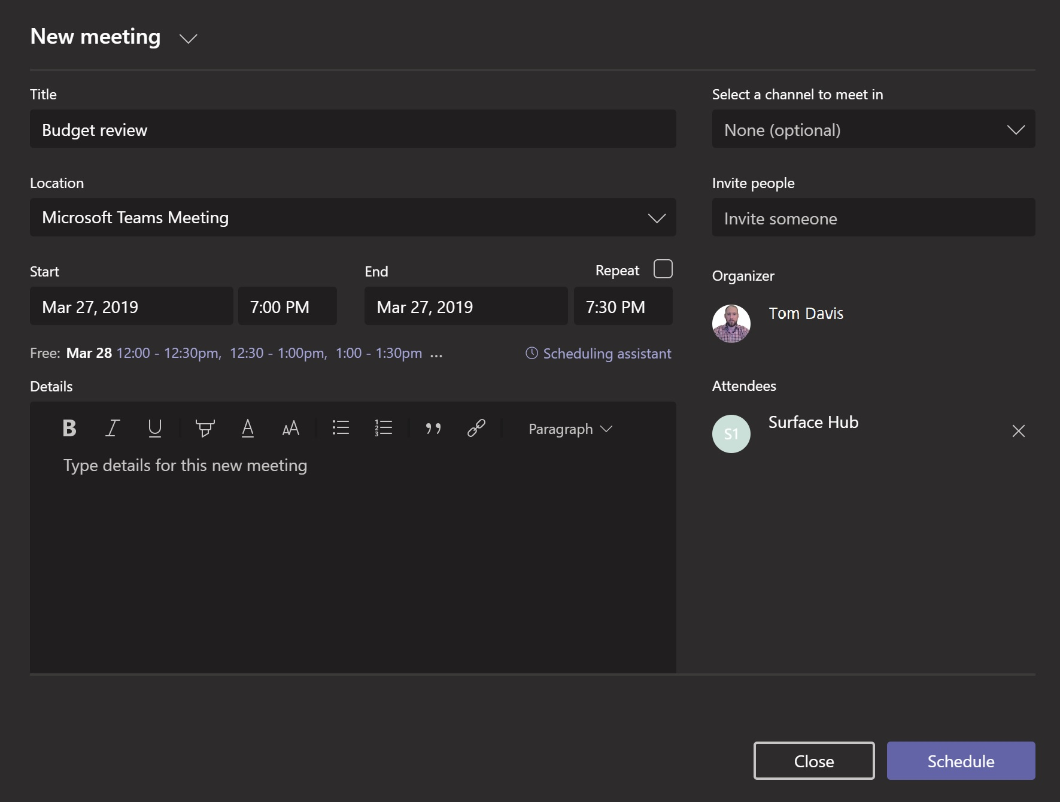

<- Back to Table of Contents

Slide 4
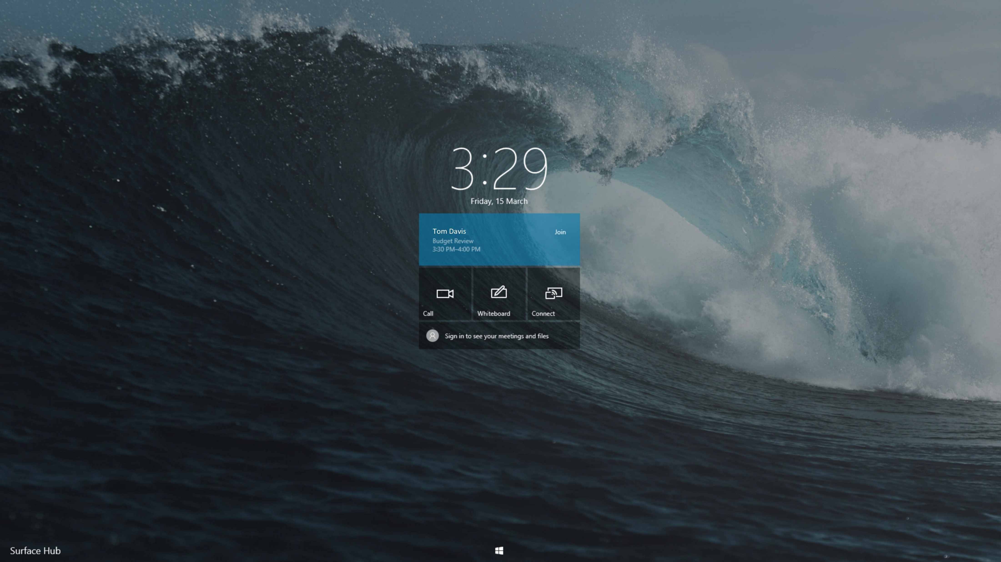


<- Back to Table of Contents

Slide 5
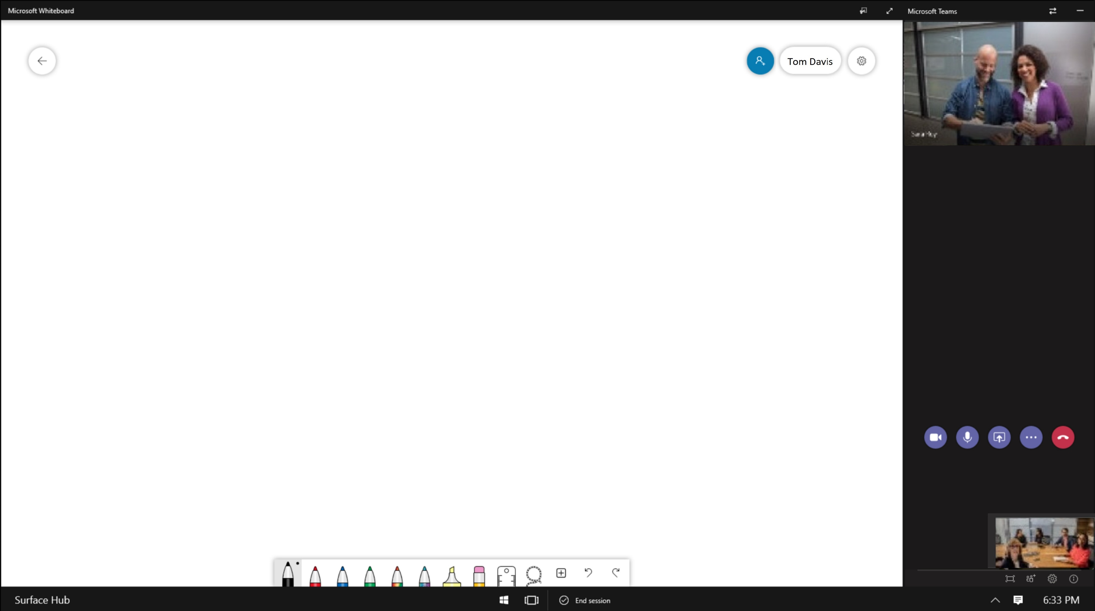


<- Back to Table of Contents

Slide 6







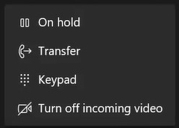
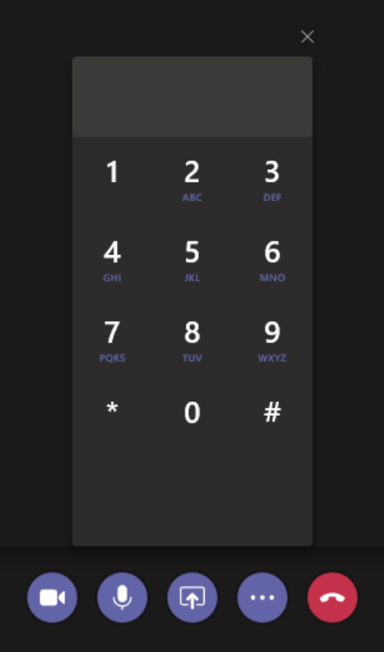
<- Back to Table of Contents

Slide 7
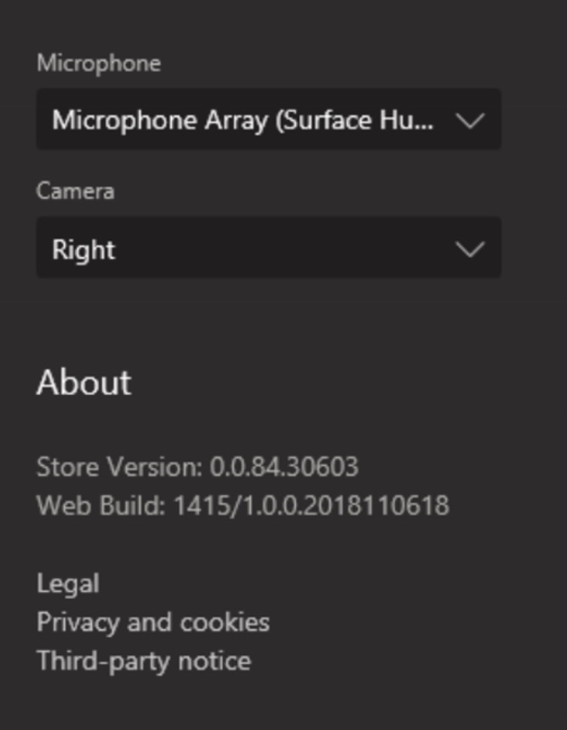





<- Back to Table of Contents

Slide 8
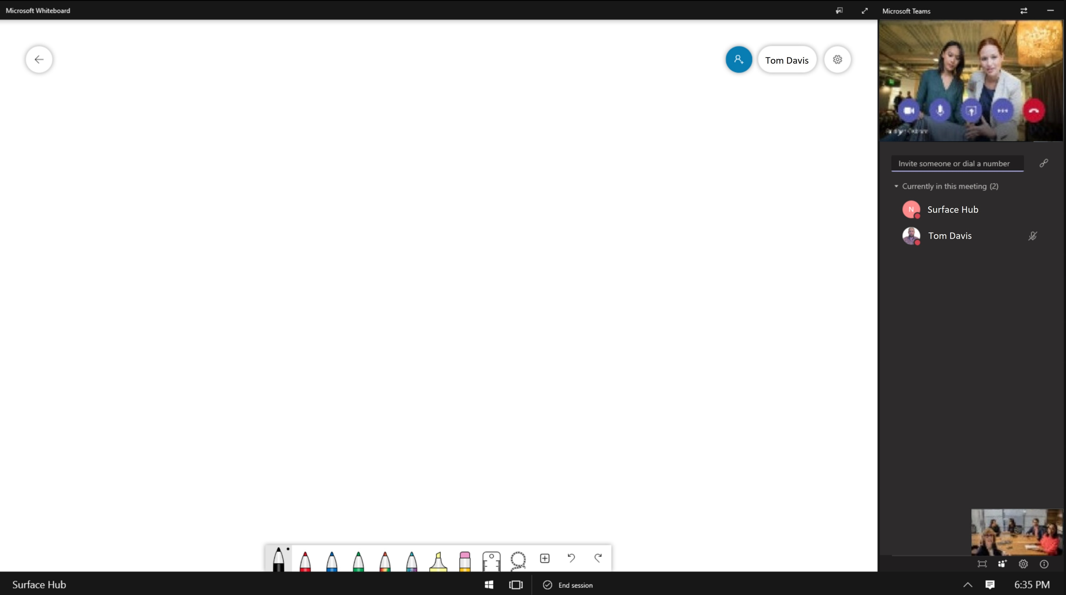

<- Back to Table of Contents
<- Back to Table of Contents

